Slide 1
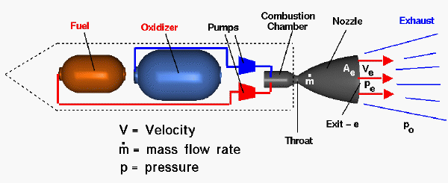
Rocket Physics The Thrust Curve
LabRat Scientific
© 2018

Slide 2
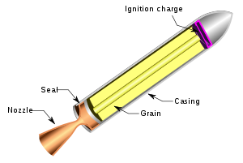
Thrust Curves
A rocket motor will have a thrust level that will vary over time. The graph of the thrust versus time is known as a “thrust curve”.
The thrust curve is driven by the design of the propellant grain and the nozzle.

Slide 3
Propellant Burn-Back Profile
Thrust
Time

Slide 4
Propellant Burn-Back Profile
Ignition (add heat to the fuel and oxidizer to create combustion)…
Thrust
Time

Slide 5
Propellant Burn-Back Profile
Boost Phase
The propellant burning surface gets larger as the propellant burns forward and outwards. As a result, the thrust increases over time. This is known as the “boost phase”
Thrust
Time

Slide 6
Propellant Burn-Back Profile
Boost Phase
The propellant burning surface gets larger as the propellant burns forward and outwards. As a result, the thrust increases over time. This is known as the “boost phase”
Thrust
Time

Slide 7
Propellant Burn-Back Profile
Boost Phase
The propellant burning surface gets larger as the propellant burns forward and outwards. As a result, the thrust increases over time. This is known as the “boost phase”
Thrust
Time

Slide 8
Propellant Burn-Back Profile
At some point, the propellant burns to the casing wall and there is a sudden drop in the burning surface area. Now the propellant is only burning forward and the burning surface area remains constant. This is known as the “sustainer phase”
Sustainer Phase
Thrust
Time

Slide 9
Propellant Burn-Back Profile
At some point, the propellant burns to the casing wall and there is a sudden drop in the burning surface area. Now the propellant is only burning forward and the burning surface area remains constant. This is known as the “sustainer phase”
Sustainer Phase
Thrust
Time

Slide 10
Propellant Burn-Back Profile
At some point, the propellant burns to the casing wall and there is a sudden drop in the burning surface area. Now the propellant is only burning forward and the burning surface area remains constant. This is known as the “sustainer phase”
Sustainer Phase
Thrust
Time

Slide 11
Propellant Burn-Back Profile
At some point, the propellant burns to the casing wall and there is a sudden drop in the burning surface area. Now the propellant is only burning forward and the burning surface area remains constant. This is known as the “sustainer phase”
Sustainer Phase
Thrust
Time

Slide 12
Propellant Burn-Back Profile
At some point, the propellant burns to the casing wall and there is a sudden drop in the burning surface area. Now the propellant is only burning forward and the burning surface area remains constant. This is known as the “sustainer phase”
Sustainer Phase
Thrust
Time

Slide 13
Propellant Burn-Back Profile
At some point, the propellant burns to the casing wall and there is a sudden drop in the burning surface area. Now the propellant is only burning forward and the burning surface area remains constant. This is known as the “sustainer phase”
Sustainer Phase
Thrust
Time

Slide 14
Propellant Burn-Back Profile
Burnout
When the burning surface gets to the front of the motor, there is nothing left to burn, so the thrust drops to zero. This point is known as “burn out”
Thrust
Time

Slide 15
Propellant Burn-Back Profile
The “Thrust Curve” is created when we connect all of the thrust points…
Thrust
Time

Slide 16
Total Impulse
Total Impulse is the area under the thrust curve. Unit analysis shows that the units of Impulse are Lb-Sec. The Impulse tells us how much energy is produced by the rocket motor.
35000
We can approximate the area under the thrust curve using simple geometry or we can slice if up into thin rectangles (a.k.a. Integration)
30000
25000
20000
Thrust (lb)
15000
10000
5000
0
0
5
10
15
20
25
30
35
Time (s)

Slide 17
Specific Impulse
SPECIFIC IMPULSE is the Total Impulse of the motor divided by the Weight of the propellant. Specific Impulse has the units of Sec.
Pound * Sec
Specific Impulse = ----------------- = Sec
Pound
Specific Impulse tells us how much energy is contained within the fuel itself.

Slide 18
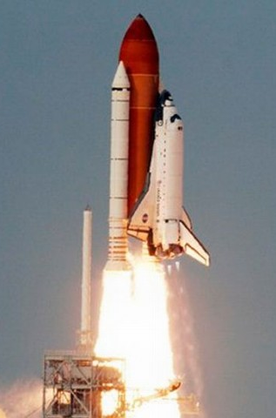
Rocket engine designers select a propellant with a specific impulse that best suits the job and the budget. Liquid propellants have higher specific impulses than solids, but liquid fueled motors are more complex and more expensive.
Some times high performance (and the associated higher complexity and cost) is needed (i.e. Space Shuttle), and sometimes its not (i.e. sounding rockets).

Slide 19
Questions?

